Slide 1


NEXT GEN EMPLOYABILITY PROGRAM
CREATING A FUTURE-READY WORKFORCE
Student Name :
Affan Quraishi
Student ID :
College Name :
STU678255e9cd6511736594921
Trinity Academy of Engineering ,Pune

Slide 2
CAPSTONE PROJECT SHOWCASE
Project Title
AuctoEssence
Representing the true essence of refined bidding experience
Abstract | Problem Statement | Project Overview | Proposed Solution | Technology Used | Modelling & Results | Conclusion | Q&A

Slide 3
Abstract
1
Development of an Online Auction Platform using ReactJS for the frontend and ExpressJS for the backend, enabling real-time bidding and auction management.
2
Users can view live auctions, place bids, and receive real-time updates through a dynamic and responsive user interface built with ReactJS.
3
The ExpressJS backend handles user authentication, bid processing, and auction management, ensuring secure and efficient real-time data synchronization.
4
The ExpressJS backend handles user authentication, bid processing, and auction management, ensuring secure and efficient real-time data synchronization.

Slide 4


Problem Statement
Traditional and existing online auction platforms face issues like inefficient bidding processes, delayed updates, lack of transparency, and poor scalability. This project aims to develop a real-time, secure, and scalable Online Auction Platform using ReactJS and ExpressJS, offering a seamless and user-friendly experience for both buyers and sellers.

Slide 5

Project Overview
The Online Auction Platform is a web application designed to facilitate seamless online auctions. Built with ReactJS for the frontend and ExpressJS for the backend, the platform provides a user-friendly, real-time experience for both buyers and sellers.
Users can easily register, participate in live auctions, place bids, and track auction progress in real-time. Admins can manage auctions, control bidding times, and review bid histories. The platform ensures secure bidding, smooth data synchronization, and scalable performance, offering an efficient and interactive solution for online auctions.

Slide 6
Proposed Solution
This project proposes the development of a real-time, user-friendly, and scalable Online Auction Platform using ReactJS and ExpressJS. The solution includes:
Frontend (ReactJS):
A responsive, interactive UI with real-time bid updates and auction progress.
Backend (ExpressJS):
A secure backend to manage user authentication, bid processing, and auction synchronization.
Key Features:
User account management, secure bidding, real-time notifications, and an admin panel for auction control.
Scalable infrastructure to support growing numbers of users and auctions.
This solution ensures a smooth, engaging auction experience, overcoming limitations of existing platforms with a scalable, secure environment for buyers and sellers.

Slide 7
Technology used
Frontend:
ReactJS: A JavaScript library for building dynamic and responsive user interfaces with real-time updates.
CSS/HTML: For designing and structuring the user interface with responsiveness.
Backend:
ExpressJS: A web application framework for Node.js, used to handle API requests, user authentication, and auction management.
Node.js: A JavaScript runtime that enables server-side programming and handles real-time operations efficiently.
Database:
MongoDB: A NoSQL database for storing auction data, user information, and bid history.
API Testing:
Postman: Used for testing API endpoints and ensuring proper functionality of the backend services.
Authentication & Security:
JWT (JSON Web Tokens): For secure user authentication and session management.
Bcrypt: For password hashing and secure user data storage.
Hosting:
MERN Stack: MongoDB, ExpressJS, ReactJS, and Node.js for the full-stack development of the application.

Slide 8
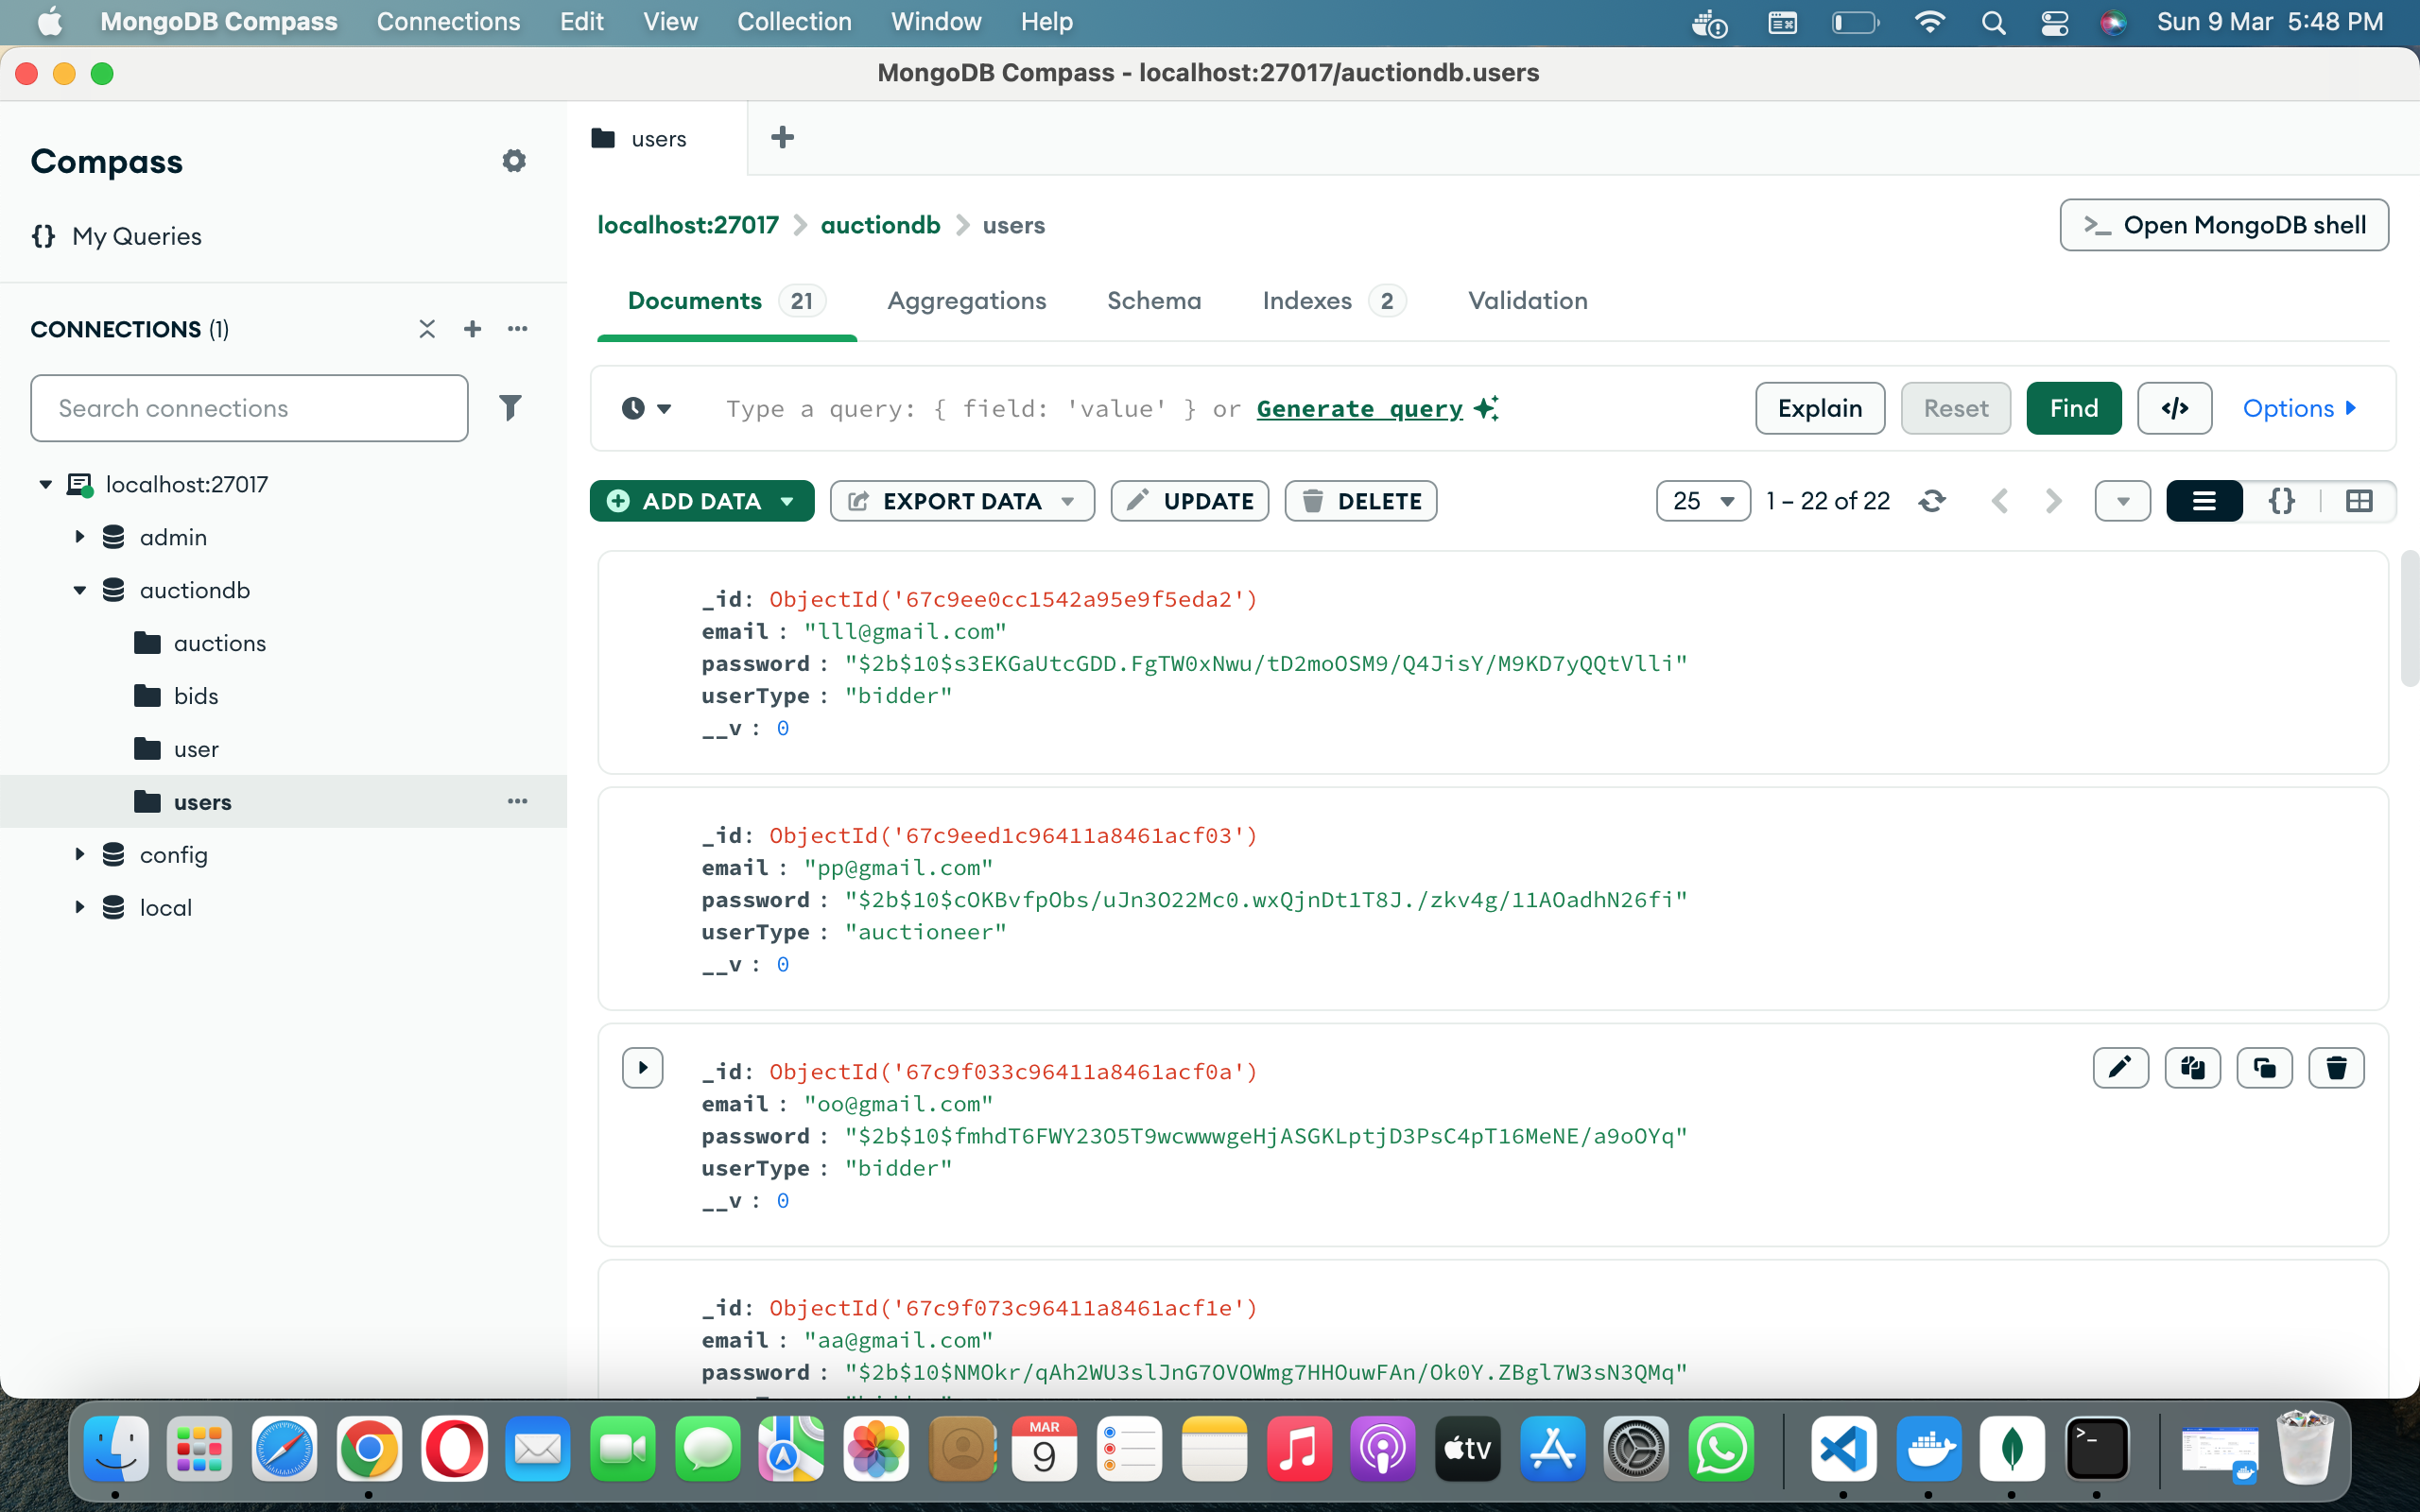
Modelling & Result

Slide 9
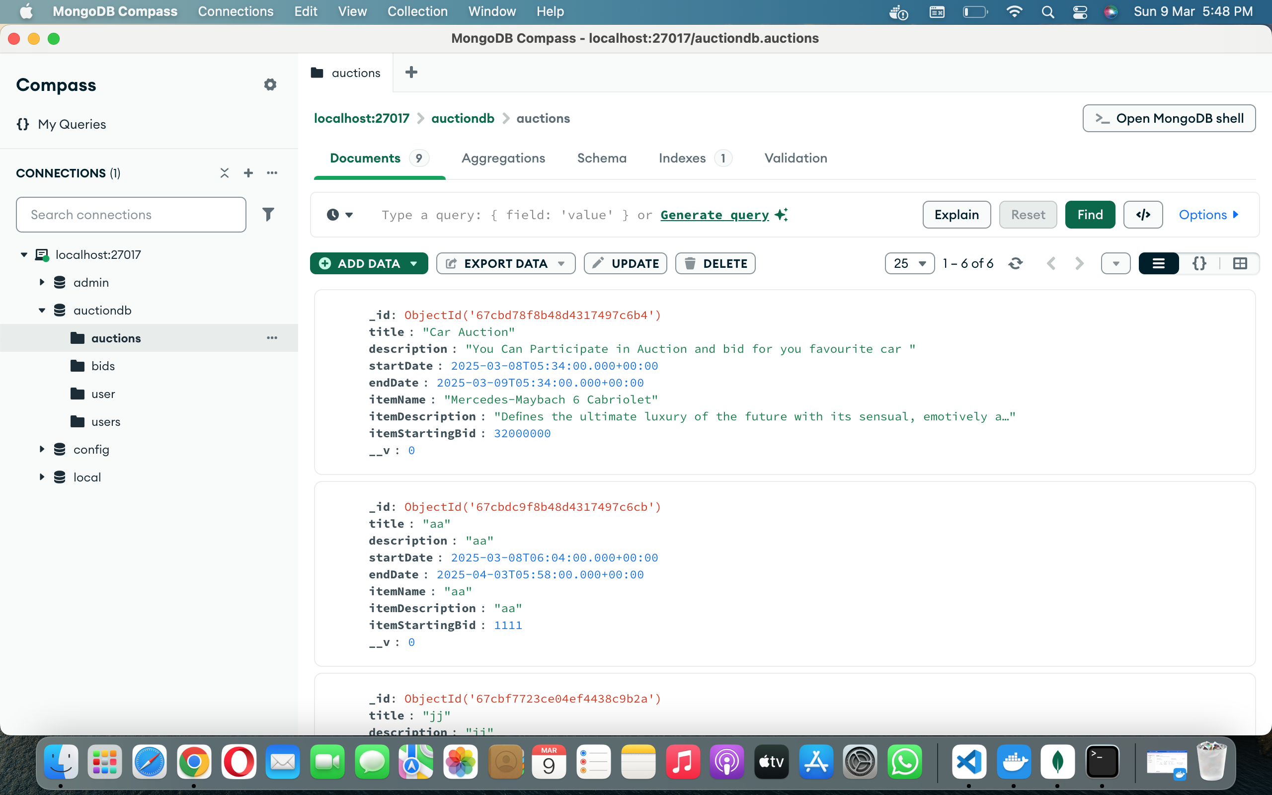
Modelling & Result

Slide 10

Conclusion
The Online Auction Platform built with the MERN stack provides a scalable, real-time solution for online auctions. It offers a secure, user-friendly experience for buyers and sellers, with real-time bidding, smooth auction management, and robust authentication. This platform successfully addresses common issues in traditional auction systems, providing an efficient and reliable online auction environment.

Slide 11


Notes:
Thank You !!

